Slide 1

Customer Churn Prediction Using Machine Learning Telecom Industry Case Study
Pranay Sadawarti
May 2026

Slide 2
Agenda
Introduction to Customer Churn
Problem Statement
Dataset Overview
Exploratory Data Analysis
Data Preprocessing
Model Building & Training
Model Evaluation
Results & Comparison
Deployment / Prediction System
Conclusion & Future Scope

Slide 3
What is Customer Churn? Definition: When a customer stops using a company's product/service Impact on Telecom: -High acquisition cost vs retention cost -Revenue loss -Affects brand reputation Business Goal: Predict customers who are likely to churn → Take preventive actions

Slide 4
Problem Statement Predict whether a customer will churn or not using historical data
Dataset Overview
Total Records: 7043
Total Features: 21
Target: Churn (Binary)
Feature Types:
Categorical: 17
Numerical: 3 (tenure, MonthlyCharges, TotalCharges)
Source: Kaggle / IBM Sample Dataset

Slide 5

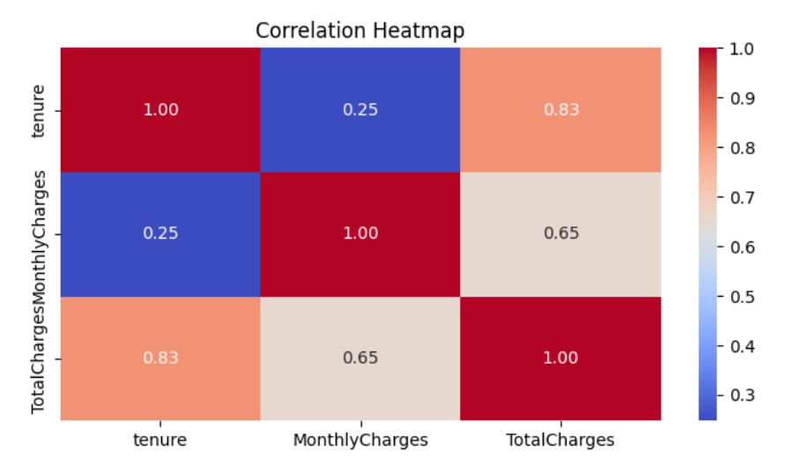
Exploratory Data Analysis (EDA)
-Churn Rate: ~26.5%
-Senior Citizens more likely to churn
-Month-to-month contract customers have high churn
-Fiber optic users have higher churn rate
-Higher Monthly Charges → Higher Churn

Slide 6
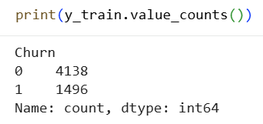
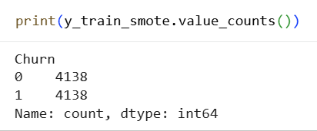
Data Preprocessing -Dropped customerID -Handled TotalCharges (object → numeric) -Label Encoding for all categorical columns -Train-Test Split (80:20) -SMOTE applied to handle class imbalance
Before SMOTE: 4138 vs 1496
After SMOTE: 4138 vs 4138
6

Slide 7
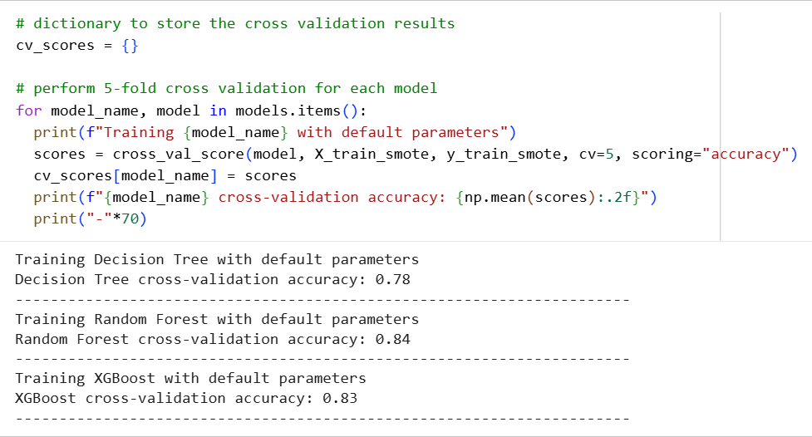
Model Selection
Selected Model: Random Forest Classifier
Model | CV Accuracy
Decision Tree | 0.78
Random Forest | 0.84
XGBoost | 0.83
7

Slide 8
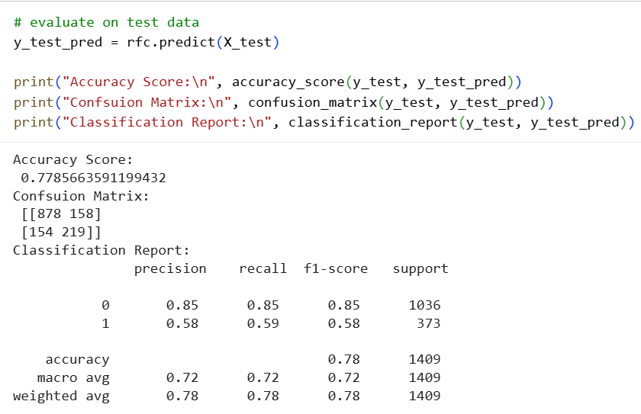
Model Performance Test Results: Accuracy: 77.86% Precision (Churn): 58% Recall (Churn): 59% F1-Score (Churn): 58%
8

Slide 9
Feature Importance
Prediction System
Saved model using pickle
Created user input interface
Example Prediction shown in notebook
Can be deployed as:
Streamlit App
Flask API
Web Application
Tenure
Contract
MonthlyCharges
PaymentMethod
OnlineSecurity etc.

Slide 10
Business Impact -Early identification of at-risk customers -Targeted retention campaigns -Reduced churn rate → Increased revenue -Better resource allocation
Conclusion
-Successfully built a churn prediction model with 77.86% accuracy
-Random Forest performed best
-SMOTE helped handle imbalance

Slide 11
Thank you

